Slide 1
ABAP Part I
Lesson 10: Reporting Events

Slide 2
Lesson Objectives
After completing this lesson, participants will be able to -
Identify the different events to trigger the Interactive report.
Purpose and usage of reporting events and its flow.
How to format the list output.
How to use the conditional and unconditional page breaks.
Illustrate the Interactive reporting events.
AT LINE-SELECTION and AT USER-COMMAND.
Illustrate using the menu painter.

Slide 3
Reporting Events
Event Blocks in Executable Programs
When you run an executable program, the program flow is controlled by the external events in the ABAP runtime environment. The following diagram (Next Slide) shows the sequence of the events.
The events in the gray box are only processed if you have entered a logical database in the program attributes. The AT SELECTION-SCREEN event is only processed if a selection screen is defined in the program or the logical database linked to the program.
The other events occur when any executable program is runs.

Slide 4
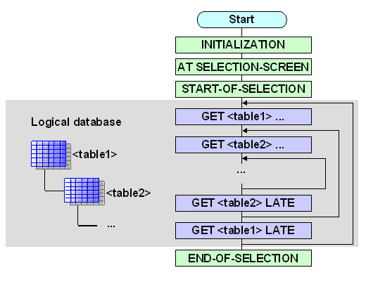
Reporting Events

Slide 5
Event Blocks in Executable Programs
The following events occur when you run a typical executable program
INITIALIZATION: Before the standard selection screen is displayed.
AT SELECTION-SCREEN: After user input on a selection screen has been processed, but while the selection screen is still active.
START-OF-SELECTION: After the standard selection screen has been processed, before data is read from the database.
END-OF-SELECTION: After all data has been read by the logical database.
TOP-OF-PAGE: In list processing when a new page starts.
END-OF-PAGE: In list processing when a page ends.
AT LINE-SELECTION: Event is triggered by either the user double clicking a particular line or using F2 to select it.
AT PF<NN>: When the user triggers the predefined function code PF<NN>.
AT USER-COMMAND: When the user triggers a function code defined in the program.
TOP-OF-PAGE DURING LINE SELECTION: Event called during list processing when a detailed list is called.

Slide 6
Initialization
The input fields of the standard selection screen can only be initialized once the program has been started.
Processed before the presentation of the selection screen can be used to initialize values in the selection screen or to assign values to any parameters or the select-options that appear on the selection screen.
If an executable program declares a standard selection screen, the same program will be automatically called again by the system once the selection screen has been executed. This triggers the INITIALIZATION event again.

Slide 7
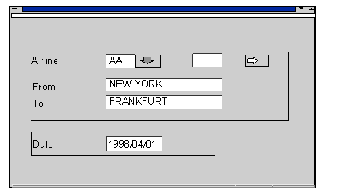
Initialization
REPORT ZCAP_REPORT.
PARAMETERS DATUM TYPE SY-DATUM DEFAULT SY-DATUM.
INITIALIZATION.
CITY_FR = 'NEW YORK'. CITY_TO = 'FRANKFURT'.
CARRID-SIGN = 'I'. CARRID-OPTION = 'EQ'.
CARRID-LOW = 'AA'. APPEND CARRID. Output:
DATUM+6(2) = '01'.

Slide 8
Demo: Initialization Event

Slide 9
At Selection-Screen
This is the basic form of events which occurs when the selection screen is being processed.
It is used to validate the information which is entered in the selection screen.
The standard selection screen is called automatically in the mid of the INITIALIZATION and START-OF-SELECTION events, either in an executable program or in the logical database which is linked to it.
Occurs after all the input data is passed to the underlying ABAP program from selection screen.
On passing the input data from Selection Screen to ABAP Program by the runtime environment, AT SELECTION-SCREEN event is triggered.

Slide 10
At Selection-Screen
Processing block is started after the user has specified all the criteria in the selection screen.
Selection Screen Processing:
Started after the INITIALIZATION event triggered.
Other events may be triggered for fields or for F4 help, depending upon user action on the selection screen.
This event can also be called on a particular parameter or select-option using At Selection-Screen on <parameter or select-option>.
To modify the Selection Screen elements before display, AT SELECTION-SCREEN OUTPUT event is used.

Slide 11
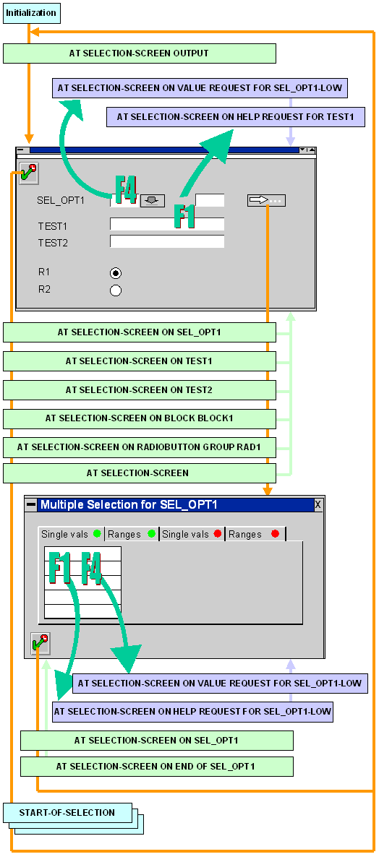
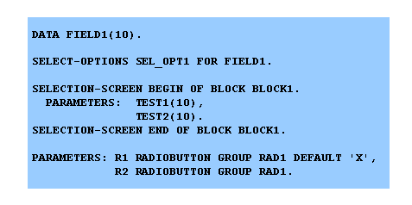
At Selection-Screen

Slide 12
Demo: At Selection Screen Event

Slide 13
Start-of-Selection
The associated event is raised by the ABAP Runtime environment during an executable program.
It is used to prepare the required data for reading and also creating the list.
Processing block is executed after processing the selection screen
All the data is selected in this block.
All the main processing on the data except for interactive reporting is handled in this block.
Event Occurs at:
After the selection screen has been processed.
Non-declarative statements which are written in between the report and first processing block are also processed in start of selection event.

Slide 14
End-of-Selection
This is the last event which is processed by the system.
Data which is selected and has been processed is printed to the screen in this block
This event is triggered after all the data has been read from the program/logical database before the list processor is being started.
It is also used to process the data that has been stored in sequential datasets like internal tables or extracts by the program

Slide 15
Exiting Event Blocks
Series of statements that allows to leave an event block in the program.
The processing of further statements depends on the statements and the events in which it is used.
Statements are used:
STOP
EXIT
CHECK

Slide 16
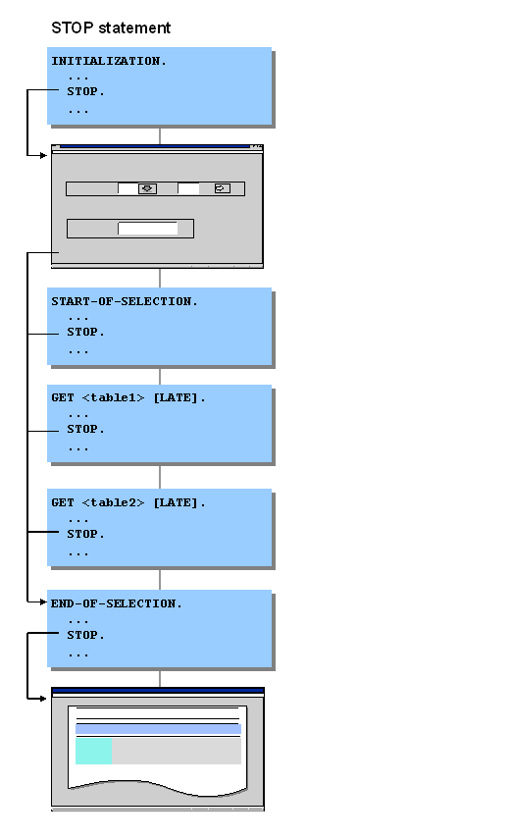
Leaving Event Blocks using STOP
If you use the STOP statement within an event block, the system stops processing the block immediately. The ABAP runtime environment triggers the next event according to the following diagram:

Slide 17
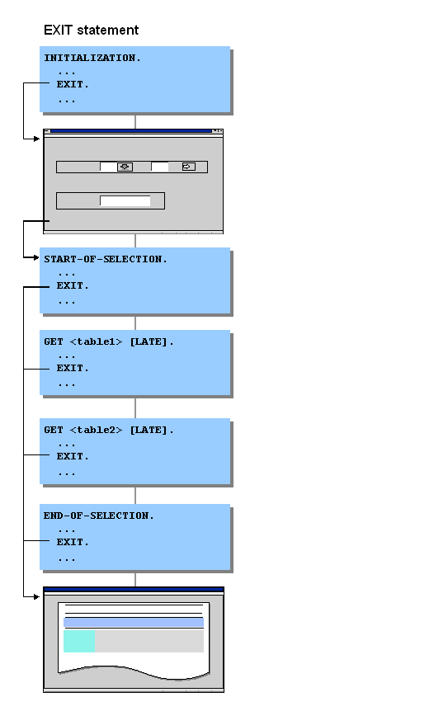
Leaving Event Blocks using EXIT
From the START-OF-SELECTION event onwards, the system starts the list processor directly when the EXIT statement occurs, and displays the list.
If the EXIT statement occurs in a loop using DO, WHILE, or LOOP, it is the loop that terminates, not the processing lock.

Slide 18
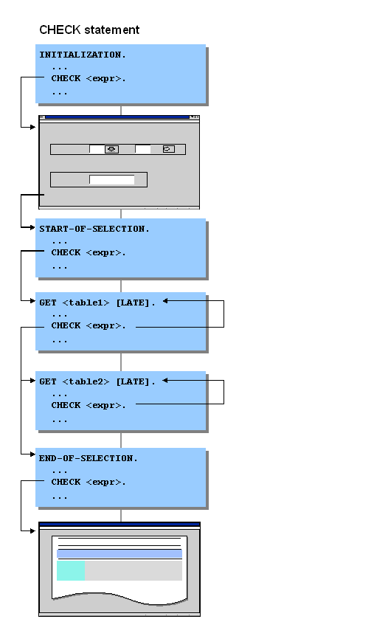
Leaving Event Blocks using CHECK
If you use the CHECK <EXPR> statement within an event block but not within a loop, and the condition <EXPR> is not fulfilled, the system exits the processing block immediately.

Slide 19
Leaving a GET event block using REJECT
The REJECT statement was specially developed for leaving GET event blocks. Unlike CHECK , EXIT and REJECT always refers to the current GET event block. The REJECT statement allows you to exit a GET event block directly from a loop or a subroutine.

Slide 20
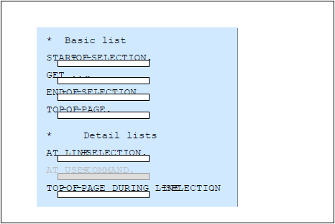
Event Blocks in Executable Programs
The events START-OF-SELECTION, GET, END-OF-SELECTION, TOP-OF-PAGE and END-OF-PAGE can be used only to create basic lists. Once you leave a basic list, these events are no longer processed.
Detail lists are created using three basic events: AT LINE-SELECTION, AT PF Status and AT USER-COMMAND.
The event TOP-OF-PAGE DURING LINE-SELECTION is used to create headers for all detail lists.

Slide 21
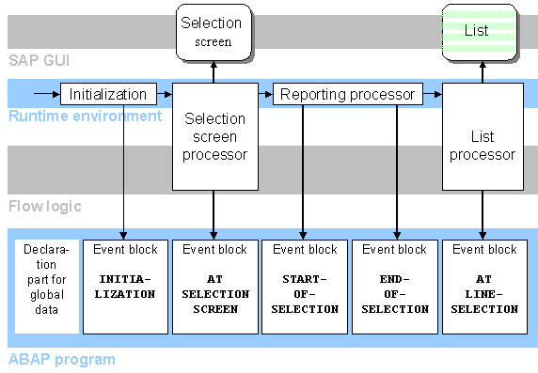
Interactive Process Flow

Slide 22
Interactive Reporting Events
Lists are the output medium for structured, formatted data from ABAP programs.
In list processing the event will be intercepted by list processor and the list is processed.
One of the following list events may be called, that depends on the function code which is triggered by the user.
AT LINE-SELECTION
AT USER-COMMAND
AT PF-STATUS

Slide 23
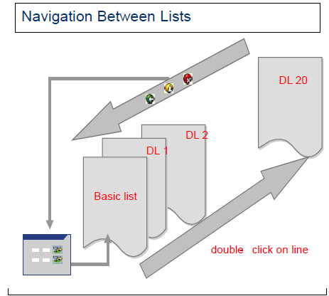
AT Line-Selection
If the user double-clicks on a report line, the AT LINE-SELECTION event is triggered. The event can also be triggered by single clicking on a report line and either pressing the Detail icon in the application tool bar, pressing F2, or entering the word PICK in the OK code field and pressing Enter.
A program can display up to 21 lists,
out of which one is the basic list
and 20 are the secondary lists.
(Detailed List DL1, DL 2……and DL 20).
The basic list is nothing but the standard
screen of an executable program.
Each list has in its own individual
memory area called a list buffer

Slide 24
Creating Detail-Lists
Detail lists are the lists created during an interactive list event
Every time the user performs an action on a list, runtime environment will check whether there is an event block defined corresponding to the function code
If an event block exists, the system field SY-LSIND is automatically increased by one and the relevant event block is then executed
The list output that arises during this event block places its data into a new list (list level) with the index which is equal to SY-LSIND
By default, the new list overwrites the previous list, however the list can also be displayed in the form of dialog box

Slide 25
Creating Detail-Lists
Each interactive list event will create a new detail list
If a list is created by the user on the next level , the system will store the previous list and displays the new one
The user can interact with whichever list is currently displayed
No standard page header can be defined for detail lists

Slide 26
Demo: Create Detail List using at Line Selection

Slide 27

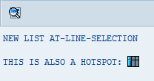
Output Fields as Hotspots
If the user clicks once onto a hotspot field, an event is triggered (for example,
AT LINE-SELECTION).To output areas as hotspots, use the following option
of the FORMAT statement:
Syntax: FORMAT HOTSPOT [ON|OFF].
REPORT ZCAP_REP. INCLUDE <LIST>. Output: START-OF-SELECTION. WRITE 'CLICK ON HOTSPOT FOR INTERACTIVE: '. FORMAT HOTSPOT ON COLOR 5 INVERSE ON. WRITE 'HOTSPOT'. FORMAT HOTSPOT OFF COLOR OFF.
AT LINE-SELECTION. WRITE / 'NEW LIST AT-LINE-SELECTION'. SKIP. WRITE 'THIS IS ALSO A HOTSPOT:'. WRITE ICON_LIST AS ICON HOTSPOT.

Slide 28
Consequences of Event Control
It is not possible to nest the Processing blocks
The event TOP-OF-PAGE cannot be used in secondary lists but TOP-OF-PAGE DURING LINE-SELECTION can be used
The event END-OF-PAGE in secondary lists is not processed by the system
The GET and GET LATE cannot be used to retrieve data for secondary lists

Slide 29
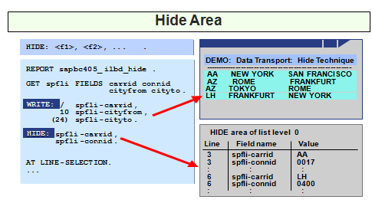
Data Transport by using HIDE
The HIDE keyword is used to store data objects and their values so they can be made available when the User selects a report line. When a line is selected, the fields that were hidden are filled with the values that you hid for that line.
It places the contents of the variable <f> for the current output line
(system field SY-LINNO) into the HIDE Area. HIDE <f>.

Slide 30
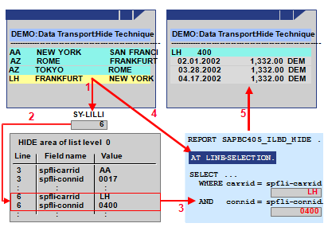
Line Selection – Hide Statement
The user selects a line for which data has been stored in the HIDE area.
The runtime system evaluates field SY-LILLI to determine the selected line.
The runtime system jumps to the point in the HIDE area where data for this line is stored.
The runtime system then inserts all values stored for the selected line in the HIDE area into their corresponding fields.
The runtime system processes the event AT LINE-SELECTION and its corresponding program processing block.
A detail list is created.

Slide 31
Demo: Hide Statement

Slide 32
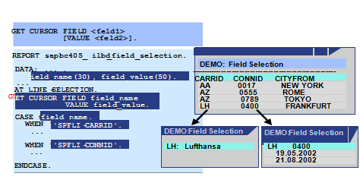
Field Selection - GET CURSOR
GET CURSOR statement is used to create detail lists according to the cursor position.
The parameter FIELD provides the name of an output field. The parameter VALUE provide the output value.
GET CURSOR FIELD <f> [OFFSET <off>] [LINE <lin>] [VALUE <val>] [LENGTH <len>].

Slide 33
Demo: Get Cursor

Slide 34
Lists in Dialog Box
List can be displayed in a dialog box instead of on the full screen using the following WINDOW statement
WINDOW STARTING AT <left> <upper> [ENDING AT <right> <lower>].
The WINDOW statement takes effect only within the interactive event’s processing block which is only for detail lists
Dialog boxes do not have either menu bar or standard toolbar
The application toolbar is seen at the bottom of the dialog box, this feature is common to all dialog boxes in the R/3 System

Slide 35
Reading and Modifying List Line
READ - Reading a Line from a List
READS LINE NUMBER LINE OF THE LIST, USUALLY AFTER A LINE SELECTION
READ LINE LINE.
READ LINE LINE OF CURRENT PAGE.
READ LINE LINE OF PAGE PAG
READ CURRENT LINE
MODIFY LINE n.
Change a List Line
INDEX IDX - Changes the corresponding line in the list at list level IDX
FIELD VALUE f1 FROM G1 ... FN FROM GN
WINDOW STARTING AT X1 Y1 ENDING AT X2 Y2.
Displays the current secondary list as a modal dialog box only up to 20 windows

Slide 36
Reading Lines from the Lists
Used to read a line from a list after an interactive list event.
READ LINE <lin> [INDEX <idx>] [FIELD VALUE <f1> [INTO <g 1>] ... <f n> [INTO <g n>]] [OF CURRENT PAGE|OF PAGE <p>].
The statement stores the contents of line <lin> from the list on which the event
was triggered (index SY-LILLI) in the SY-LISEL system field and will fill all HIDE
information that is stored for this line back to the corresponding fields
READ CURRENT LINE [FIELD VALUE <f1> [INTO <g 1>] ...].
This statement reads a line read before by an interactive event or by READ LINE

Slide 37
Demo: Read Lines from List

Slide 38
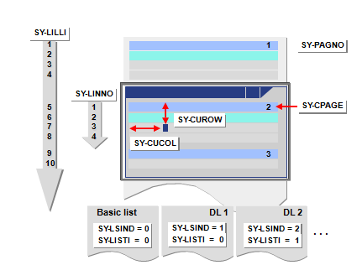
System Fields for Interactive Lists

Slide 39
System Fields for Interactive Lists
SY-LSIND Index for the current list.
SY-LISTI Index of the last list displayed.
SY-LILLI Absolute number of a selected line in the list displayed.
SY-CPAGE Number of the upper-most displayed line in the list displayed.
SY-LISEL Contents of the line from which the event was triggered.
SY-CUCOL Number of the column in the window where the cursor was last positioned in the list displayed.
SY-CUROW Number of the line in the window where the cursor was last positioned in the list displayed.
SY-STACO Number of the first column displayed in the list displayed.
SY-STARO Number of the first visible line in the top displayed page
(SY- PAGE) in the list displayed (not including header lines).
10.SY-UCOMM Function code that triggered the interactive event in the list
displayed.
11.SY-PFKEY Status of the list displayed.

Slide 40
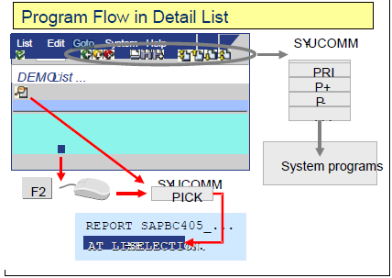
AT USER-COMMAND
If the report has a custom GUI and the user selects a menu option, the event AT USER-COMMAND is triggered. The function code assigned to the menu option can be evaluated using a CASE construct to determine which menu option was selected.
All other function codes are either intercepted by the runtime environment or trigger the event AT USER-COMMAND.

Slide 41
AT USER-COMMAND
Function codes that trigger AT USER-COMMAND must be defined in the own GUI status.
GUI status for lists can be defined and attached to list level using
SET PF-STATUS in executable program.
Function codes are used for this purpose and they will be
maintained in the GUI status of the list screen.
The GUI status will be maintained in Menu Painter tool in the ABAP Workbench.
The system assigns function codes to user actions that are list-specific.

Slide 42
Dialog Status and Title in program
Setting a Dialog-Status SET PF-STATUS <stat> [EXCLUDING <f>|<itab>] [OF PROGRAM <prog>].
This statement sets the status <stat> for the current output list.
SET PF-STATUS SPACE is used to set the standard list status.
Setting a Title for a List
SET TITLEBAR <ttl> [WITH <g1> ... <g9>] [OF PROGRAM <prog>].
The above statement will set the title of the user interface for the output list.
This will remain active for all screens until another SET TITLEBAR is specified.

Slide 43
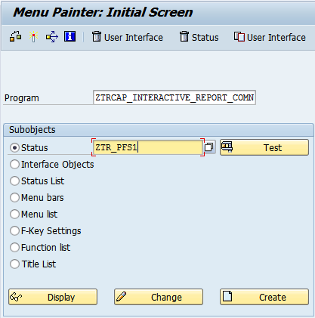
Menu Painter
It is a tool used to design the user interfaces for ABAP Programs.
The GUI status will be maintained in Menu Painter tool in the ABAP Workbench
GUI status means, the instance of the interface consisting of menu bar, a standard toolbar, an application toolbar, and a function key setting.
The GUI status and GUI
title defines how the user
interface will look and
behave in an ABAP program.
T-CODE SE41.

Slide 44
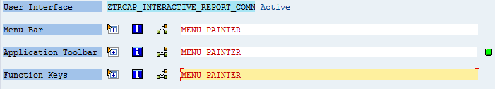
Menu Painter
Menu Bar Consists of the following the options.
Menu Bar
Application Toolbar
Function Keys

Slide 45
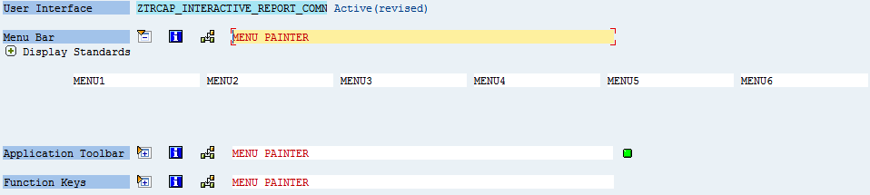
Menu Painter - Menu Bar
A menu bar may contain six menus.
Two standard menus are added by default
System
Help
The two menus are displayed at the right-hand end of the menu bar

Slide 46
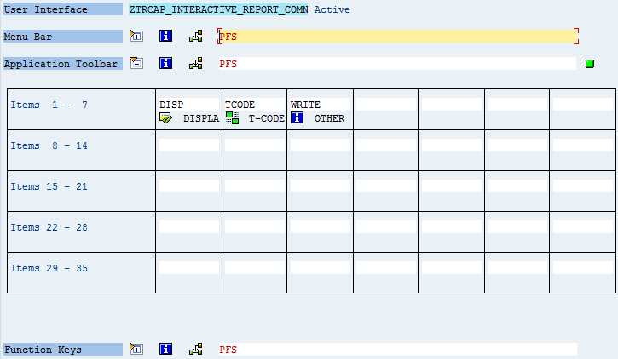
Menu Painter - Application Toolbar
A function to a function key must be assigned before it can be included in the application toolbar.
A maximum of 35 pushbuttons in the application toolbar can be included.
Application toolbar functions contains
Icon
Text or
Both Icon and Text

Slide 47
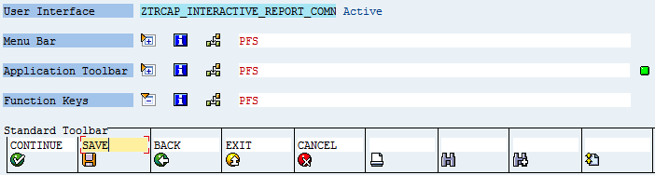
Menu Painter - Function Keys
A function keys contain the.
Standard Toolbar.
Recommended Function Key Settings.
Freely Assigned Function Keys.

Slide 48
Review Question
Question 1. ______event occurs before the standard selection screen is called.
Question 2: The ____ keyword is used to store data objects.
Question 3: _____ is a tool used to design the user interfaces for ABAP Programs.

Slide 49
Summary
In this lesson, you have learnt:
To Generate a list using simple reports
To use different events in the report
To Illustrate events triggering interactive reports
To Develop programs on Interactive reports by using the
At Line-Selection and At User-Command Events.
To Design Menus, Function Keys and application tool bar.

